Slide 1
Remote Desktop connection
29 January 2019

Slide 2
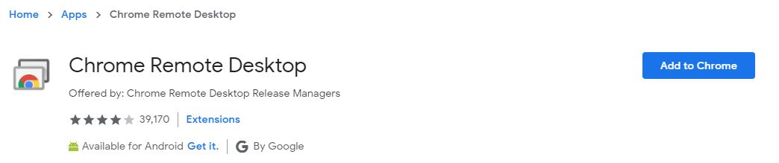
Chrome remote desktop conn
Step 1: Go to → open chrome browser --> signed with
Gmail ( ID: support@aceengineer.com and passwd:AceEngineer@2020)
Then, search “chrome.google.com/remote desktop connection”
Note: (optional) if you already have an remote desktop conn. Then try to login in
New people(user)
Click this “Add to Chrome” button
→ A new pop-up window open and click “Add app” then downloaded
→ Click “Chrome Remote Desktop” .

Slide 3
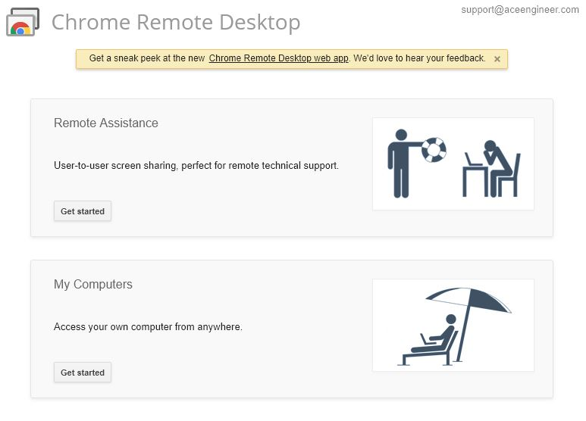
Step 2: if you done properly then it can open window like this
Or else click “launch app” → it will show this.
→ Now we have two options to select one is “remote assistance” and “my computers”
then, select “MY Computers” again select “Get started”
See your log in ID

Slide 4
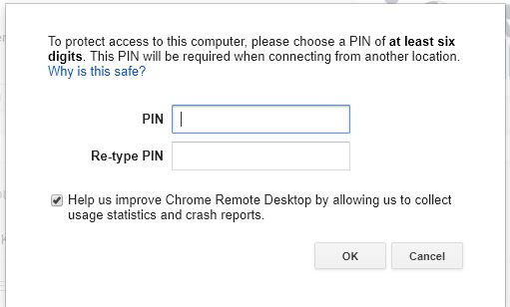
Step 3: If you click get started then click “Enable remote conn”
Then automatically window opens
You enter PIN (it contains at least 6 digits )
all are use this pin is “20142020” then, ok
It searches devices and displayed, how many
Devices are connected in this email Id.

Slide 5
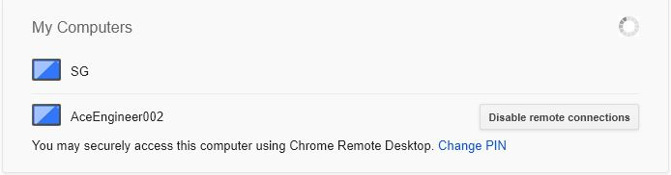
Step 4: you can select the device and type pin then you can access it

Slide 6
instructions
Both have connect to internet
If you done this process, see the downloads host file like this “chromeremotedesktophost.msi” and install it. Because we can connect desktops even we are not opened chrome browser.
(Note: Both must be opened this application, then only we connected)
If pin have same of all devices, we can easily connect to other desktop easily

Slide 7
Way Forward
In this chrome RDC, we cannot copy and paste the files. Need to resolve this.

Slide 8
THANK YOU
For the opportunity to serve!

Slide 9
Document Revision History
01 | New document | 16 June 2016 |  | VA
Rev | Description | Date |  | Author | Checked | Approved
Document No: |  |  | Client Ref:
0132-PRE-0001-01 |  |  | n/a

